Slide 1
CSE 308 Software Engineering and Information System Design Sessional
Automation of
BCB’s
Game Development Committee
Sequence diagram, State-chart diagram and Activity Diagram.
Group No: 01
Group Members:1005091
1005111
1005113
1005115
1005120

Slide 2
Subsystems
School Cricket Management System
Youth Cricket Management System
Facilities and Equipment Management System
Divisional Cricket Management System
Academy Operations Management System
Coach Management System
Control Management System

Slide 3
Sequence
Diagrams

Slide 4
School Cricket management
System

Slide 5
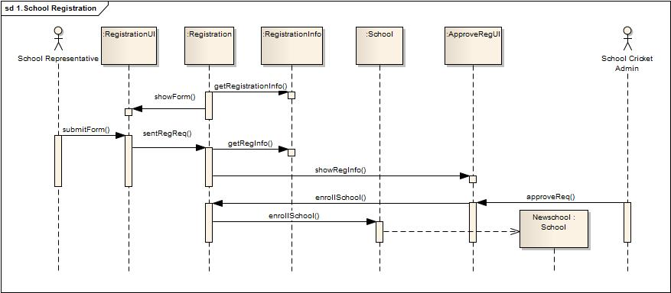
School registration:

Slide 6
Youth Cricket management
System

Slide 7
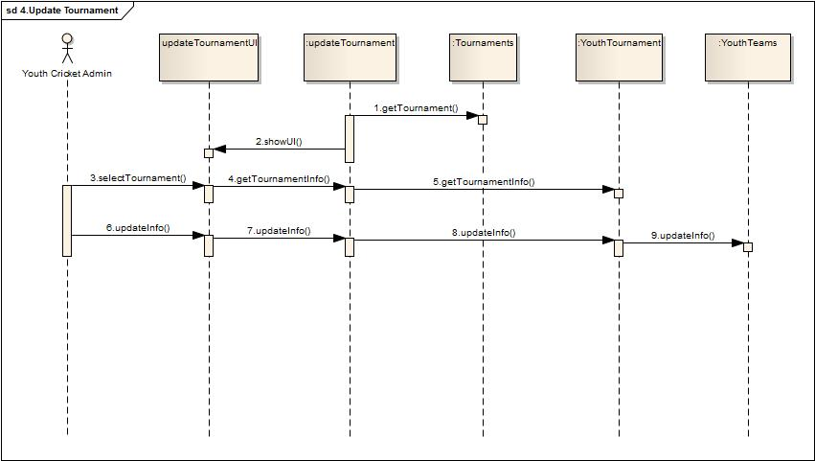
Update Tournament Info:

Slide 8
Facilities & Equipment management
System

Slide 9
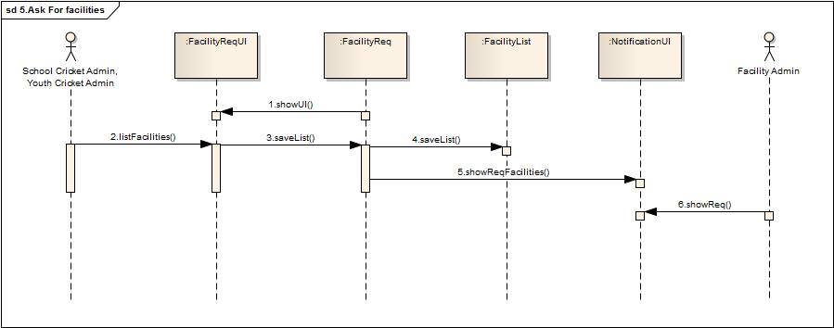
Ask for facilities:

Slide 10
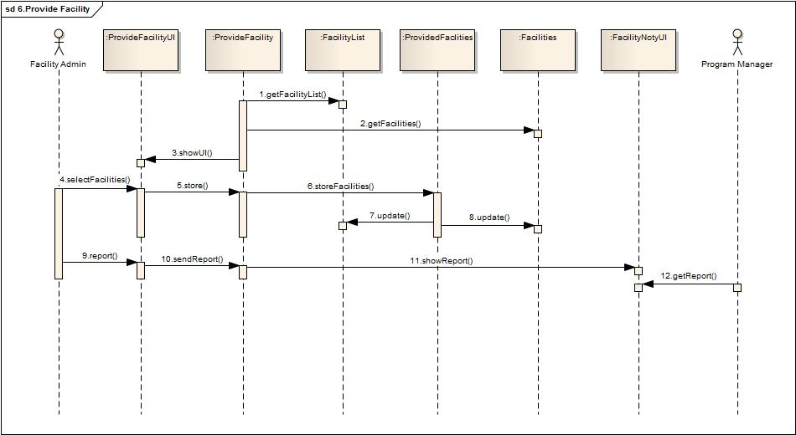
Provide Facilites:

Slide 11
Divisional
Cricket management
System

Slide 12
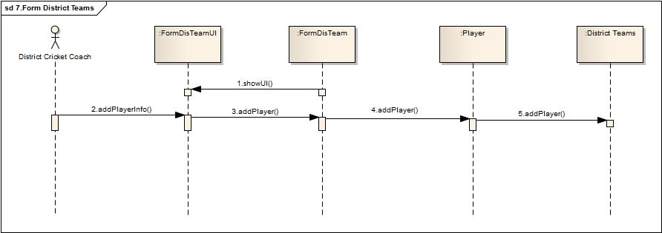
Form District Team :

Slide 13
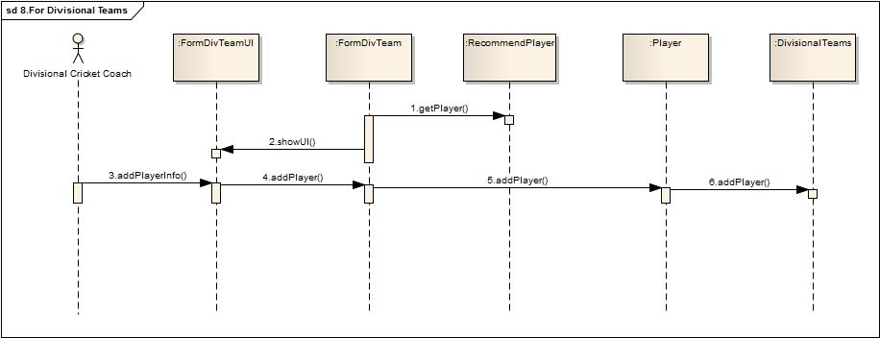
Form Divisional Team:

Slide 14
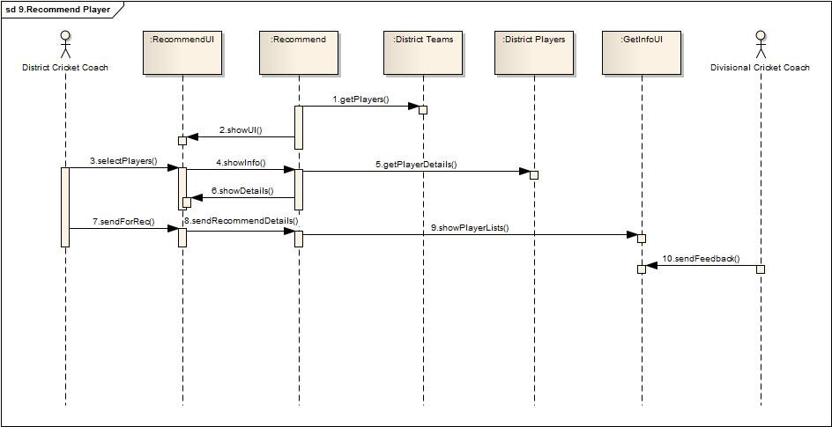
Recommend Players:

Slide 15
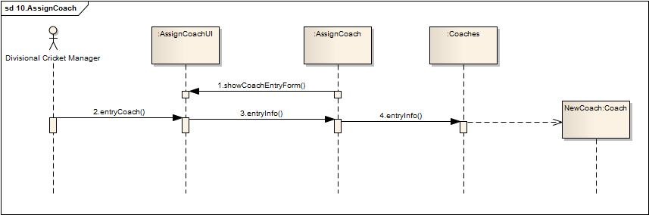
Assign Coach:

Slide 16
Academy Operations
management
System

Slide 17
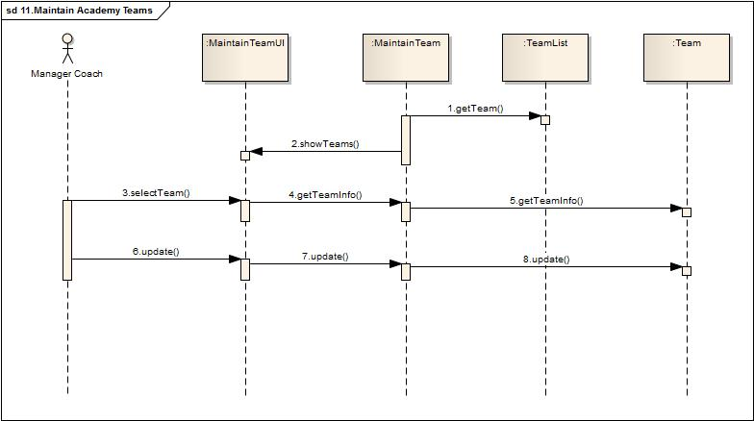
Maintain Academy Teams:

Slide 18
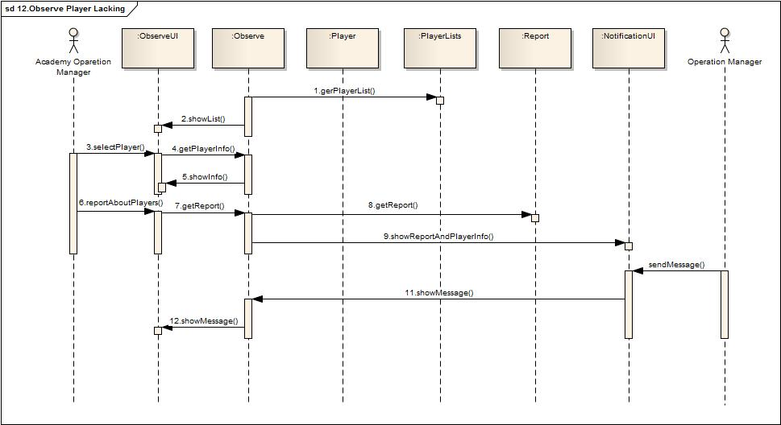
Observe Player Lacking: Class Diagram

Slide 19
Coach management
System

Slide 20
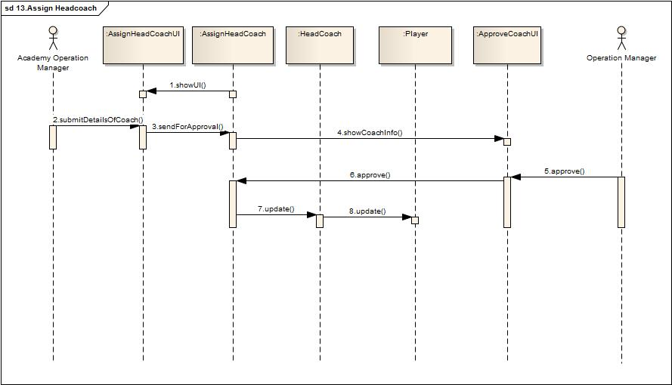
Assign Head Coach:

Slide 21
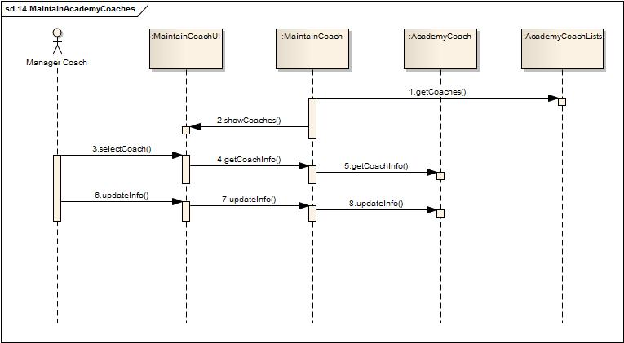
Maintain Academy Coaches:

Slide 22
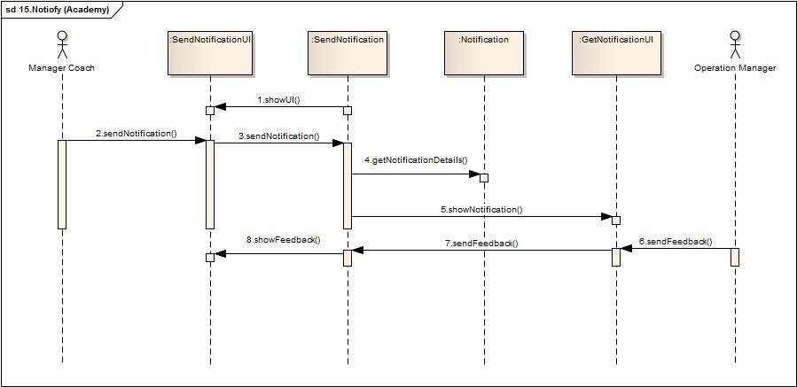
Notify:

Slide 23
Control
management
System

Slide 24
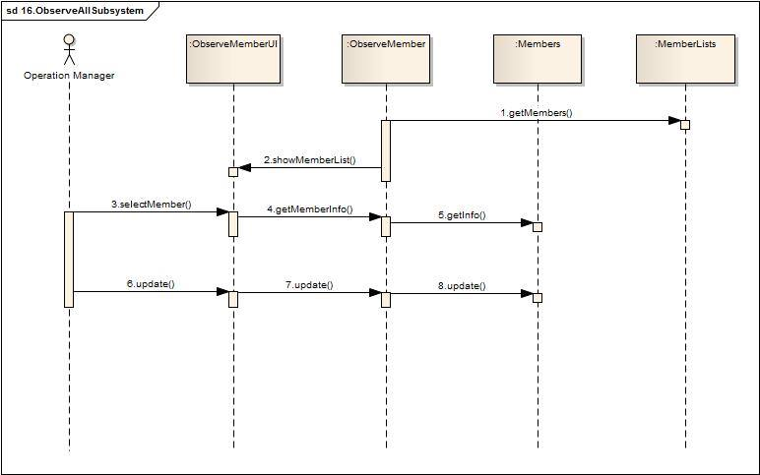
Observe All Subsystem:

Slide 25
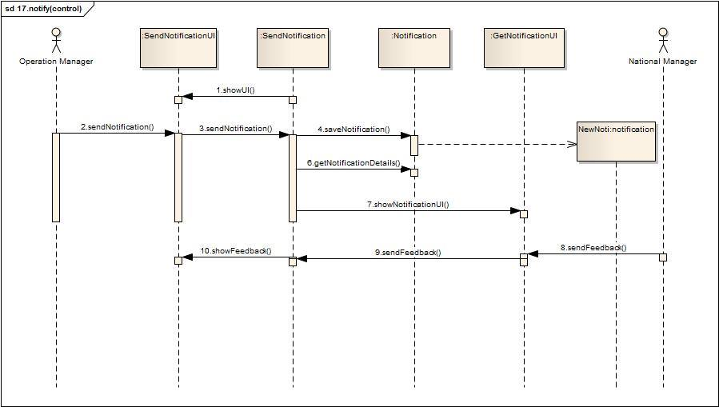
Notify:

Slide 26
State-chart
Diagrams

Slide 27
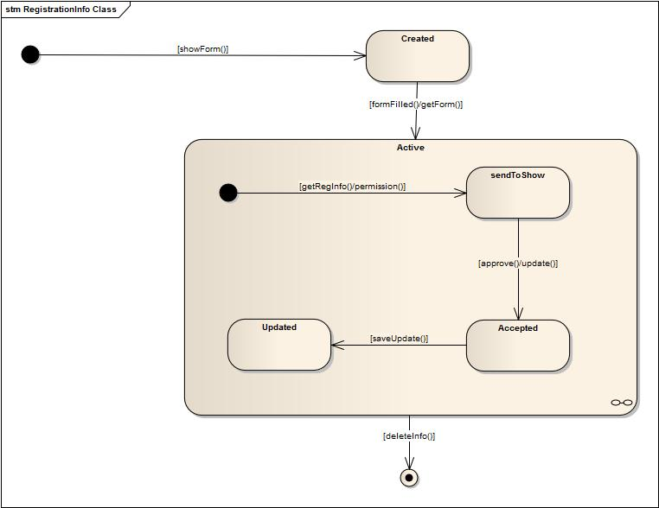
RegistrationInfo class:

Slide 28
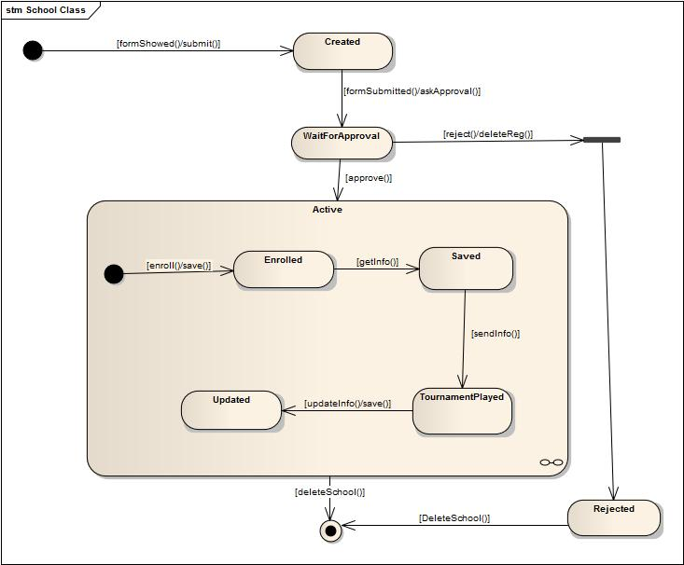
School class:

Slide 29
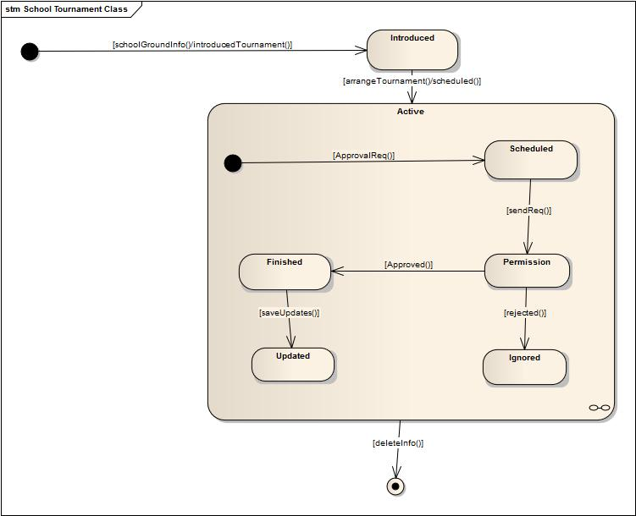
School Tournament class:

Slide 30
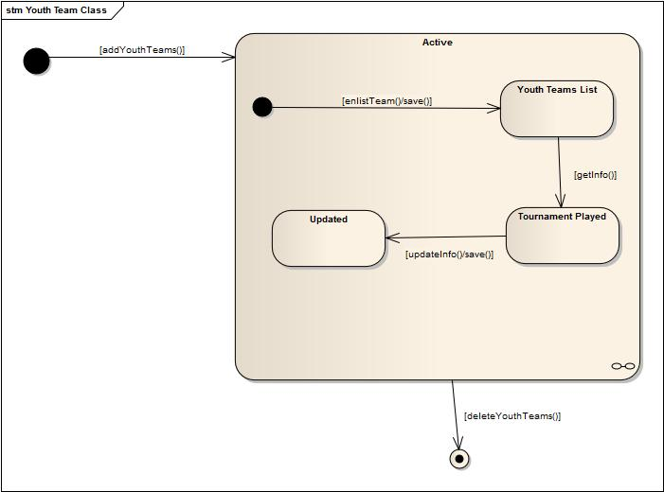
Youth Team class:

Slide 31
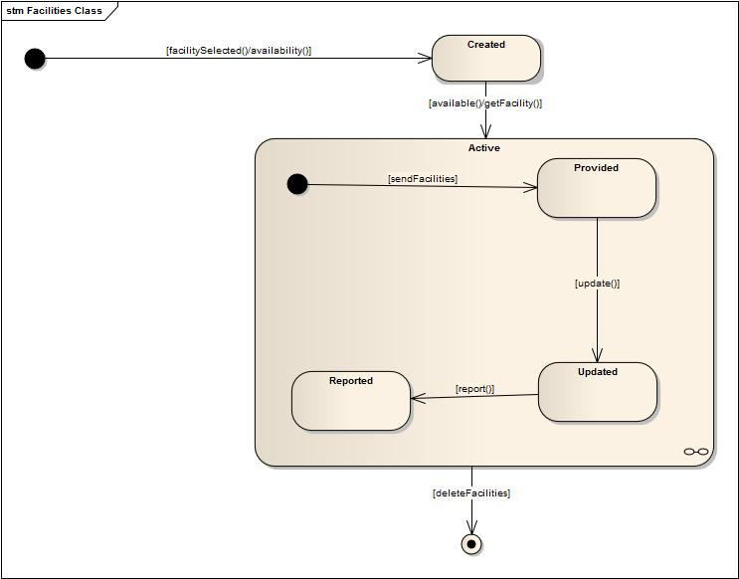
Facilities class:

Slide 32
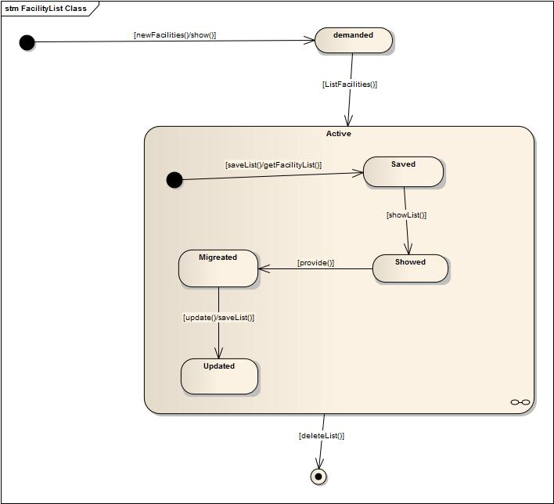
FacilityLists class:

Slide 33
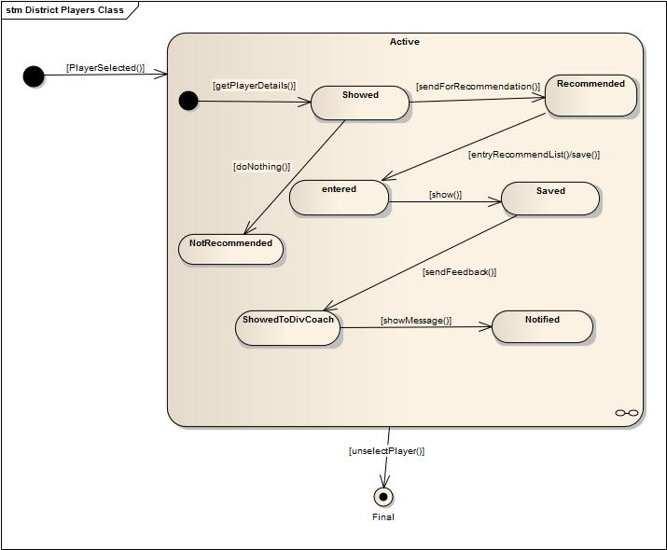
DistrictPlayer class:

Slide 34
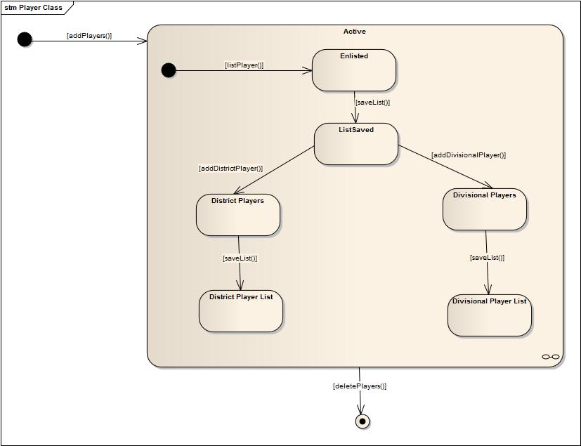
Player class:

Slide 35
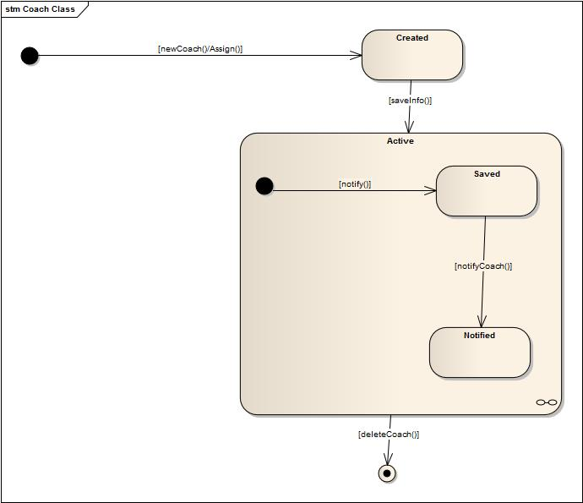
Coach class:

Slide 36
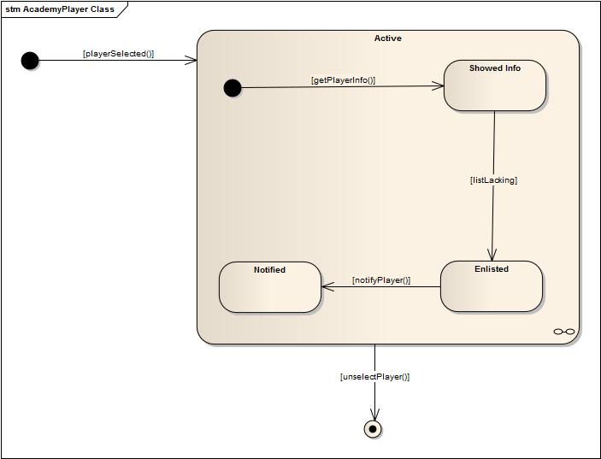
AcademyPlayer class:

Slide 37
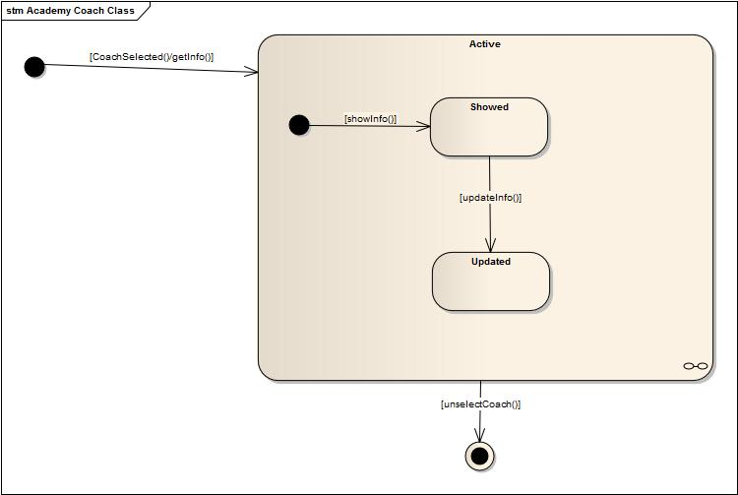
AcademyCoaches class:

Slide 38
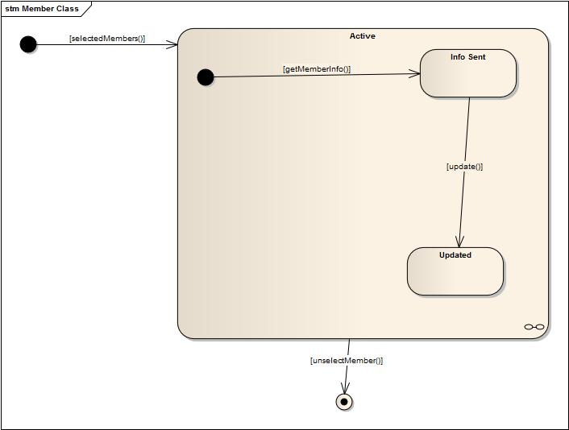
School Tournament class:

Slide 39
Activity
Diagrams

Slide 40
School registration:

Slide 41
Arrange School Cricket Tournament :

Slide 42
Arrange Youth Cricket Tournament :

Slide 43
Update Tournament Info :

Slide 44
Ask for facilities :

Slide 45
Provide Facilites :

Slide 46
Form District Team :

Slide 47
Assign Coach:

Slide 48
Observe player lacking:

Slide 49
Maintain Academy Coaches:

Slide 50
Assign Head Coach:

Slide 51
Observe all subsystems:

Slide 52
Thank You

